Slide 1
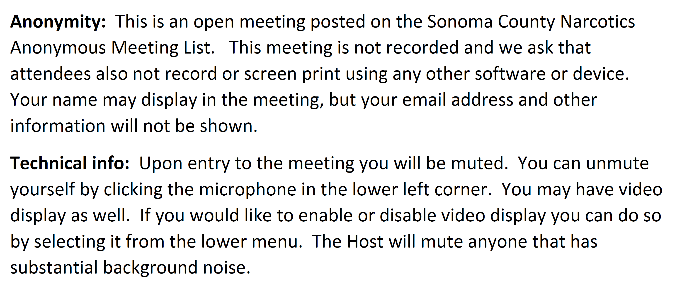
Welcome to the Sonoma Online NA Meeting
The Meeting will start at 7pm

